Slide 1

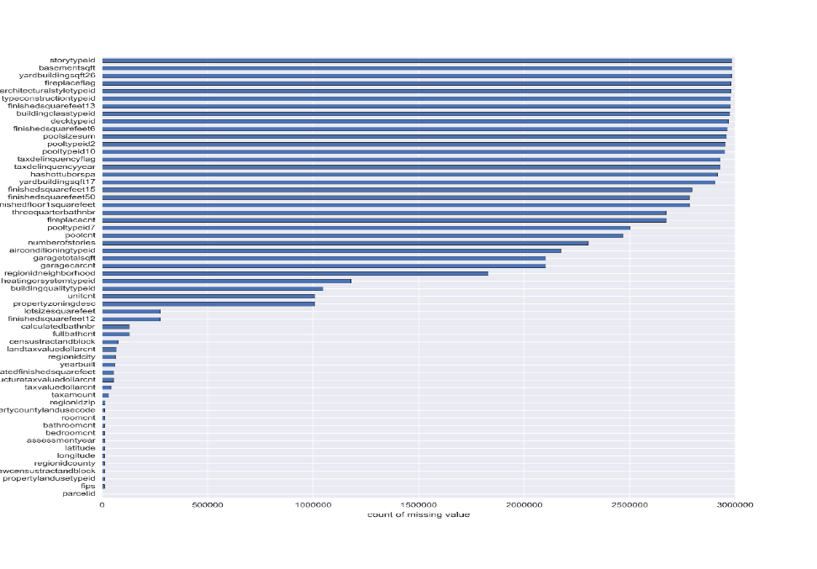
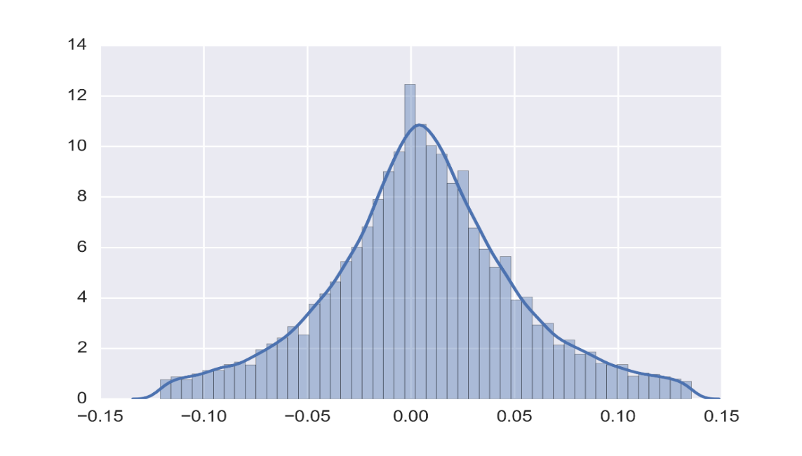
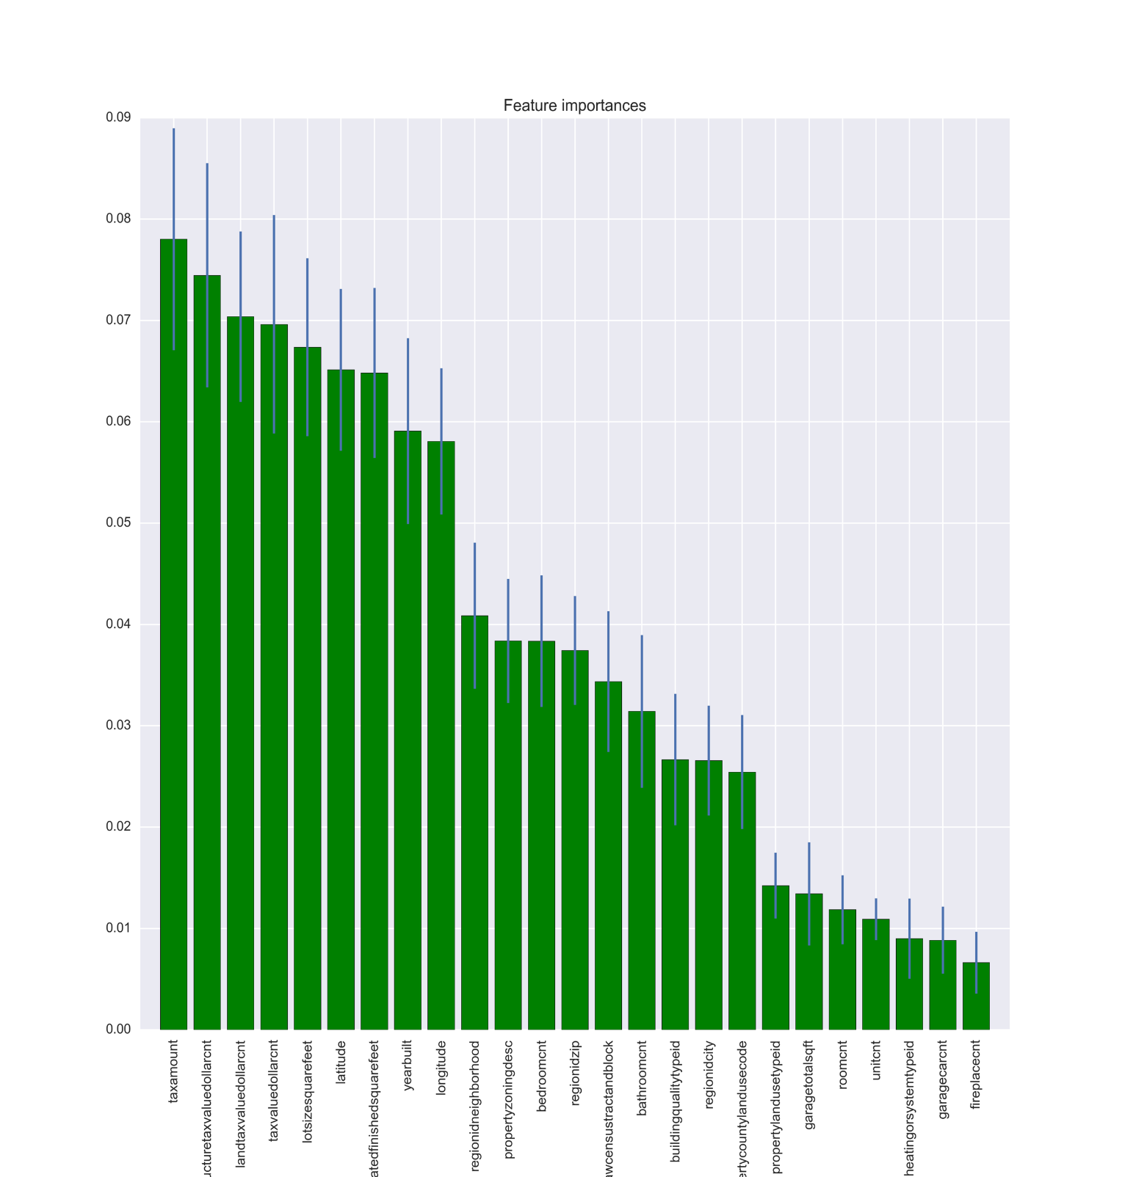
Zillow’s Home Value Prediction Chang Xu, Wenzhuo Lei, Juncheng Lu
Applied Analytics in World of Big Data
Fall, 2017
Background & Objectives
Zillow’s Zestimate is a properly home value prediction. The objective of this project is to predict the logerror which is the difference between the Zestimate and the actual sales price of homes, trying to improve Zestimate to advance prediction accuracy.
Data
Kaggle provides the training data with
actual logerror and 57 features with
lots of missing value for 2,985,217 properties.
EDA
We explored the log error
(target value) to ensure the training
data was normally distributed.
Impute missing values
Build model
Run model
Evaluate model performance
Build model
Run model
Evaluate model performance
Tune hyper-parameters
Zillow Competition Overview
Data Understanding
Set hyper-parameters
Perform cross validation
Model training
Model fitting
Predict test sets
Final Results
(MAE)
Methodology | Model | Performance
Date Imputation Drop features with missing percentage over 99% Filled with mean number of the feature Filled with 0 of binary feature Use OLS (Baselined model) | OLS Ridge Regression Random Forest | R-squared:0.004 R-squared:0.005,MAE:0.0688 MAE: 0.06866
Add KNN to modify data imputation Exploited KNN to fill feature Total Living Area based on number of bathrooms and bed rooms Fill in some feature related to the location based on longitude and latitude. Filled with most common value for some special features, like: heating system type, number of levels in house | OLS Ridge Regression Random Forest | R-squared:0.006 R-squared:0.005,MAE:0.06862 MAE: 0.06842
Dealt with data using methods above Use feature importance to better select first 25 feature | OLS Ridge Regression Random Forest | R-squared:0.005 R-squared:0.005,mae:0.06862 MAE: 0.06836
Multicollinearity Analysis Utilized VIF to better select feature | OLS Ridge Regression Random Forest | R-squared:0.007 R-squared:0.005,mae:0.06848 MAE: 0.06843
Remove features that are not significant | Ridge Regression Random Forest | R-squared:0.007, mae: 0.06852 MAE: 0.06853
Created different models | Gradient Boost | MAE: 0.06823
Conclusion
The large amount of missing value was the most challenge part in this project, imputation strategy and feature engineering were important to reduce prediction error, furthermore, we tried different models, the Gradient Boost gives the best result. For more work, we plan to add new feature and try hyper-parameter tuning.
For more deployment, the methods in this project can be applied to solve regression problems in many areas such as marketing, finance and so on.

